Slide 1
Fire Entrapment Avoidance

Slide 2
Course Outline
3 to 4 hour course.
Designed for contract crew personnel.
Recognized by the BCWS and is a mandatory safety course.
Expands on fire entrapment information from the S-100.
Evaluation Criteria:
- there is a Written Exam.
- you need 70 % on the exam to pass.

Slide 3
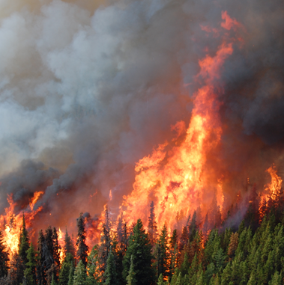
Course Outline - This Presentation Will:
Define fire entrapment on the fireline.
Discuss fire entrapment hazards.
Review LACES.
Discuss when and how to disengage from a fire.
Analyze how to survive a fire entrapment scenario.
Crown Fire

Slide 4
Learning Objectives
Having a safety first attitude on wildfires.
Fire entrapment avoidance procedures.
The LACES safe work protocols.
Understanding situational awareness and the critical factors.
Recognizing when it is time to disengage.
Surviving in a fire entrapment scenario.

Slide 5
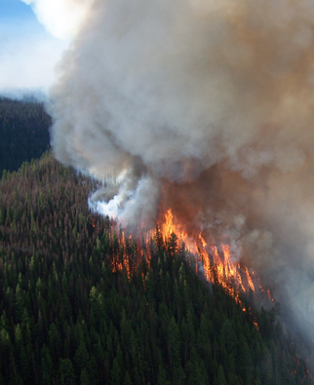
Course Overview - Why this Material is Taught:
Wildfires are powerful and unpredictable.
Fire entrapment is a major hazard.
Firefighters need to be as safe as possible.
Entrapment avoidance is critical and hazards need to be assessed.
Fire Moving Upslope

Slide 6
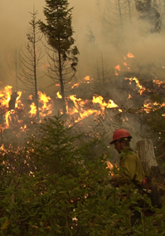
Course Overview - The Basics
Fire entrapment occurs when fire and weather conditions change.
Escape routes are cut off.
Firefighters cannot use safety zones.
Is a life threatening situation.

Slide 7
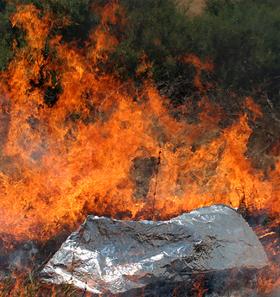
BC Wildfire Service and Fire Shelters
Firefighters received training until 2005.
No longer use fire shelters.
Numerous reasons for this decision.
The BCWS now meets the standards of all Canadian Wildfire agencies under CIFFC.
New Foil
Shelter

Slide 8
A Safety First Attitude
Wildland firefighting is a dangerous job.
Injuries and deaths occur if safe work procedures are ignored.
Firefighter safety is key.
No suppression activity is as important as maintaining safety.
Firefighters work to prevent injuries.
A ‘Safety First Attitude’ is mandatory.

Slide 9
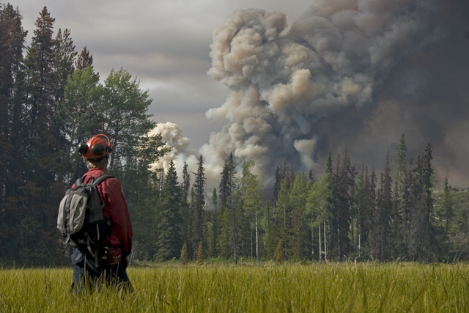
Fire Entrapment
Fire entrapment occurs when fire activity increases.
Areas along the fireline are no longer safe.
Unexpected changes may block escape routes.
There is no way to get to safety zones.
Assessing
Fire Activity

Slide 10
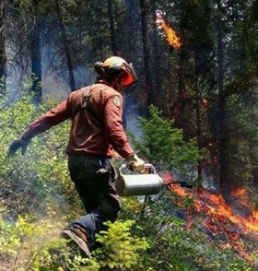
Fire Entrapment Avoidance
Use of LACES.
Use of proper fire attack methods.
Use of safe fire suppression strategies and tactics.
Consider current and predict fire behaviour.
Recognize the entrapment hazards present.
Burning Out
Excess Fuels

Slide 11
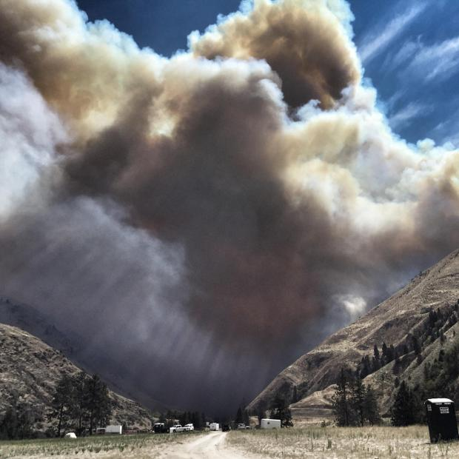
Entrapment Hazards - What to Watch-Out For:
Hazardous forest fuels for consumption.
Hazardous changes in the weather conditions.
Hazardous topographical features near the wildfire.

Slide 12
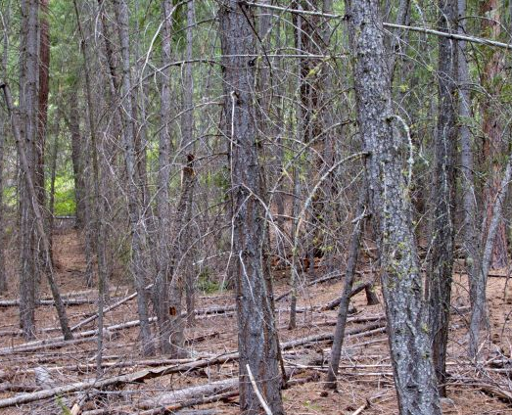
Hazardous Fuels
Fine, flashy fuels.
Tightly spaced fuels.
Dead or diseased fuels.
Unburnt fuels inside the control line.
Unburnt fuels on steep slopes.
Any fuels with low moisture.
Forest
Fuels

Slide 13
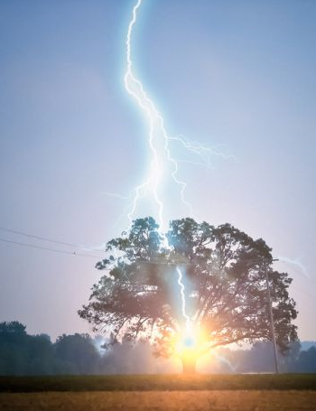
Hazardous Weather
The wind causes the most unpredictable conditions.
High temperature and low humidity.
Dry thunderstorms and cold fronts with high winds.
Long droughts in an area.

Slide 14
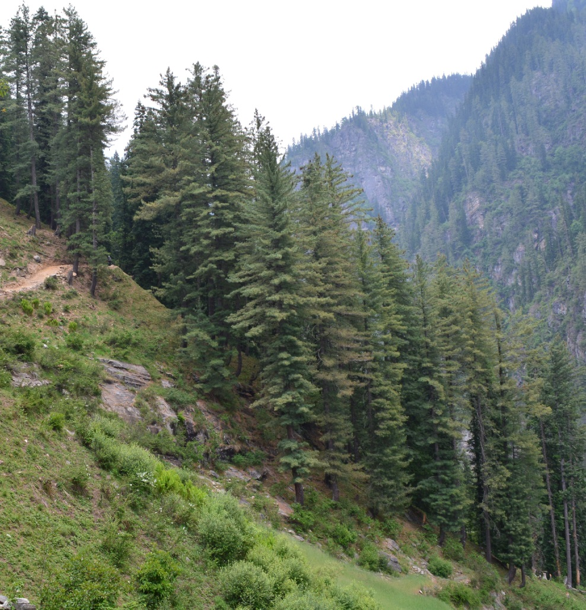
Hazardous Topography
Steep slopes.
Southern and southwestern aspects - more direct sunlight.
Chimneys, gullies and canyons.
Ridge tops with erratic winds.
Extreme Slope

Slide 15
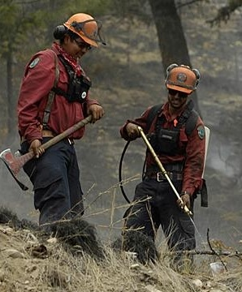
Fireline Responsibilities
Supervisors must ensure all firefighters get hazard updates.
Supervisors need to monitor and assess fire activity.
Everyone must maintain situational awareness.
Firefighters have to know where escape routes and safety zones are.

Slide 16
Situational Awareness (SA)
Is a perception and understanding of the factors in your environment.
It is crucial for hazard avoidance in the Wildfire Environment.
Firefighters must:
  Perceive - realize there is a problem.
  Comprehend - determine all factors involved.
  Take Action - make the appropriate decisions.

Slide 17
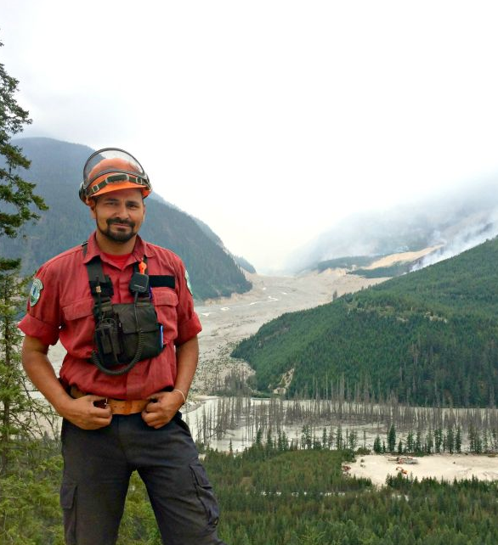
A Supervisor’s Role
Supervisors are:
Trained to recognize changes in fire behaviour.
Required to monitor fire conditions.
Responsible for communicating entrapment hazards to all fire personnel.
Wildfire Assessment

Slide 18
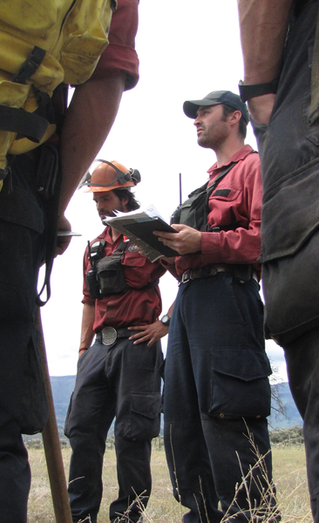
A Supervisor’s Role
Continued
Needs to give clear instructions.
Must ensure subordinates understand instructions.
New work assignments require subordinate confirmation especially if conditions change.
Complete daily pre-work safety briefings.

Slide 19
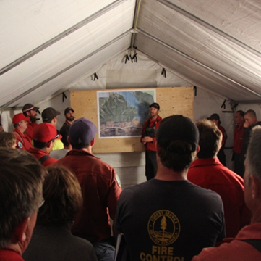
Pre-Work Safety Briefing
Discuss Chain of Command and crew assignments.
Designate Lookouts (as needed).
Determine Anchor Points.
Confirm an effective Communications plan.
Establish Escape Routes leading to Safety Zones.
= LACES!

Slide 20
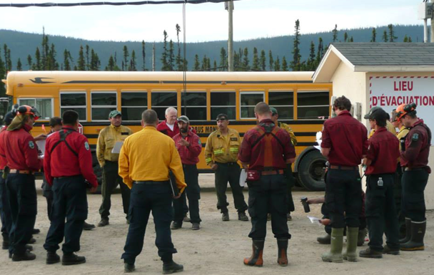
Pre-Work Safety Briefing
Review the following:
Location of first aid equipment.
Current fireline hazards.
Safe work procedures.
Current and predicted fire behaviour.
Fire suppression strategies and tactics.
Current suppression tasks and progress.
Crew work assignments.

Slide 21
LACES
Is a safety system used to protect fire personnel.
This system needs to be in place before suppression activities start.
Allows for assessments and updates on fire activity.
Establishes evacuation routes and refuge areas.

Slide 22
LACES
LACES allow firefighters to:
Continuously assess and monitor the fire.
Work from a secure area with limited fire potential.
Receive updates on fireline hazards.
Withdrawal from the fireline quickly to sheltered areas.
Avoid entrapment scenarios.

Slide 23
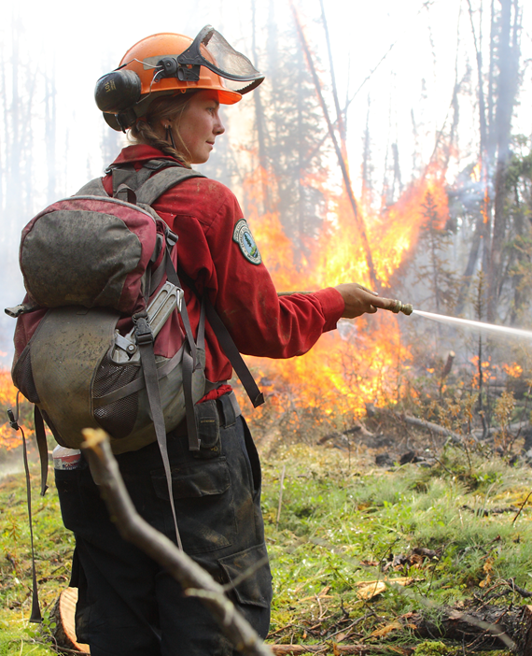
Situational Awareness and Fire Entrapment Avoidance
Firefighters need to be aware of changes in the wildfire environment.
Recognizing hazards is critical for reaction time.
The appropriate actions must be taken immediately.

Slide 24
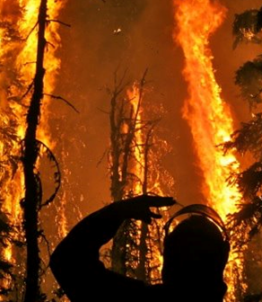
Situational Awareness and Fire Entrapment Avoidance
SA is challenged by the following factors:
Increased fire activity.
Firefighter fatigue.
Insufficient or poor transfer of information.
Task overload.
A group mentality.

Slide 25
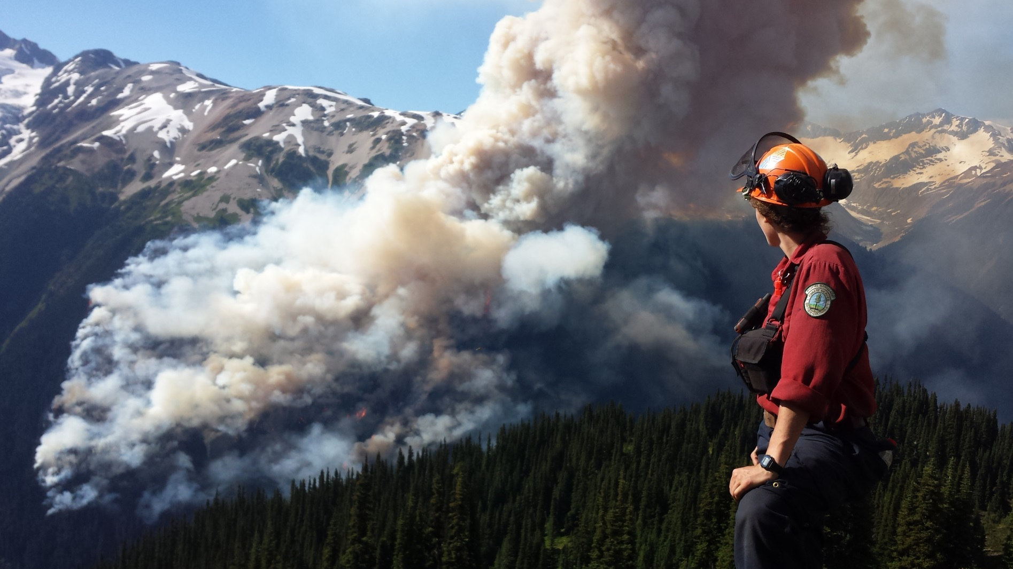
Lookouts

Slide 26
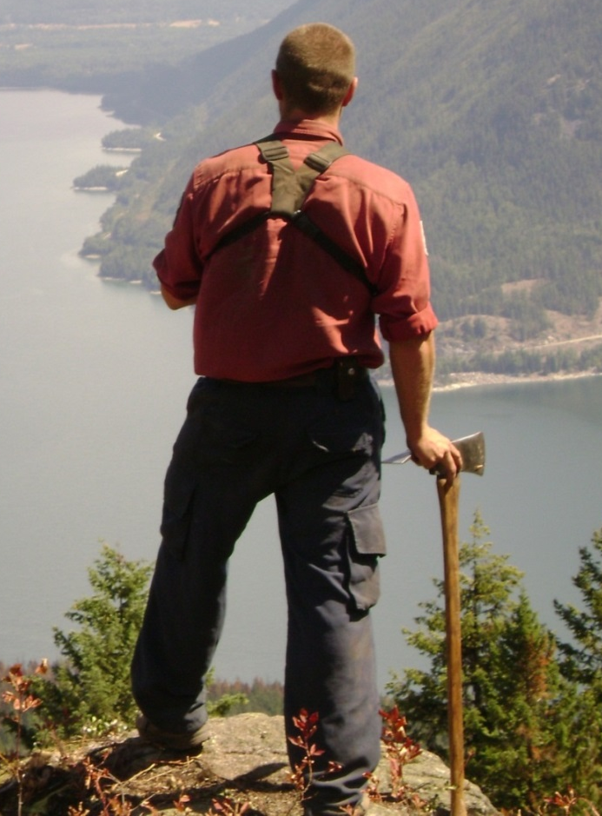
Lookouts
Are experienced fire personnel.
Observe the fire from a good vantage point.
Must be able to see the fireline.
Update fire crews about changes in:
  Fire activity.
  Weather conditions.

Slide 27
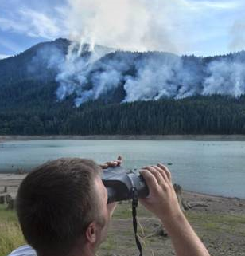
Lookouts
Good Vantage Point
Are posted if there is a need.
Need to be good communicators.
Must have knowledge of fuel types and fire behaviour.
Will work together with other lookouts.

Slide 28
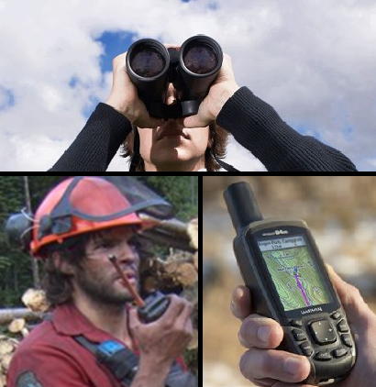
Lookouts
A lookout should have the following supplies:
A radio with extra batteries.
A compass.
A map and an Incident Action Plan (IAP).
A weather kit and notepad.
Binoculars if at distance.

Slide 29
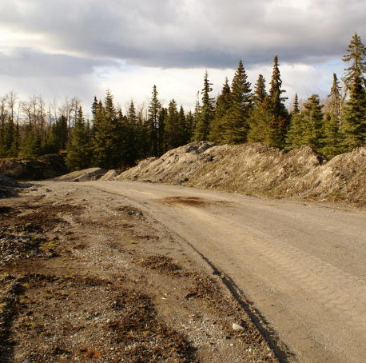
Anchor Points
Are pre-existing fire barriers.
Points where control lines start or finish.
No potential for a fire to burn this area.
Can use roads, rivers, rocky terrain, lakes, swamps and previously burnt areas.
From a Gravel Road

Slide 30
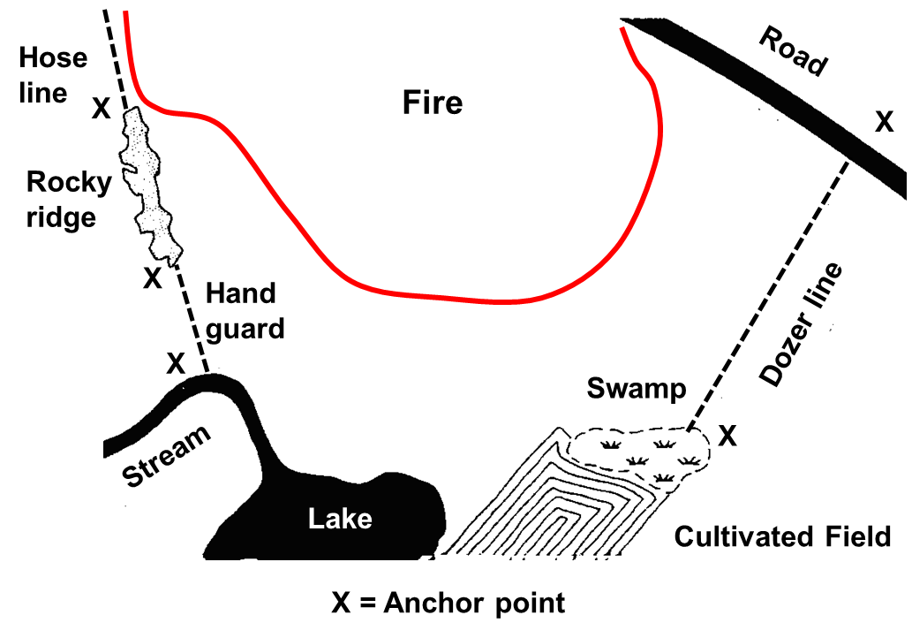
Anchor Points

Slide 31
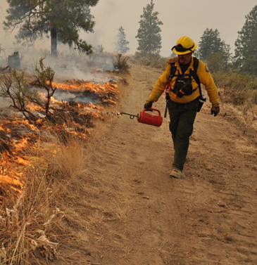
Anchor Points
Need to be secured while constructing control line.
Use suppressed edges of a fire adjacent to control line.
Can burn out fuel along a control line.
Adds an extra safe area for firefighters.
Burning Out to Secure Anchor

Slide 32
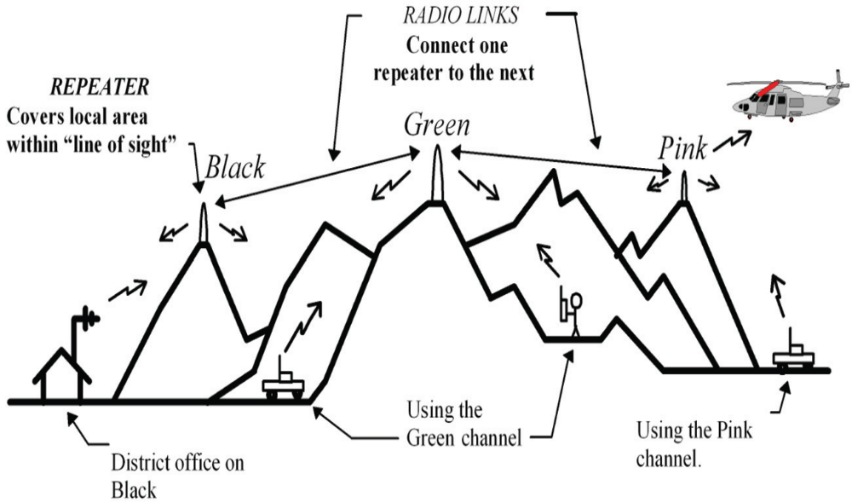
Communications

Slide 33
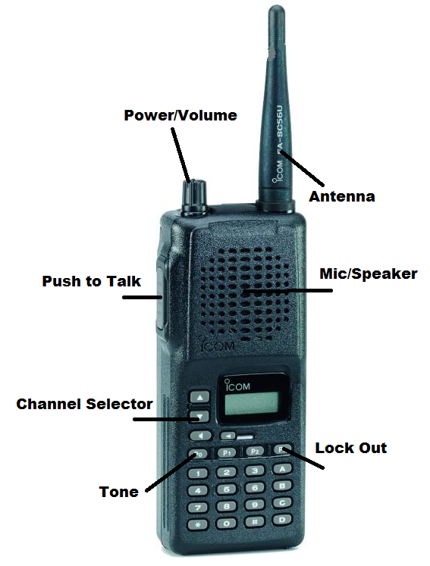
Communications by Radio
Are established before any work commences.
Supervisors must give clear instructions.
Supervisors ensure all instructions are understood.
Firefighters must ask for clarification if needed.

Slide 34
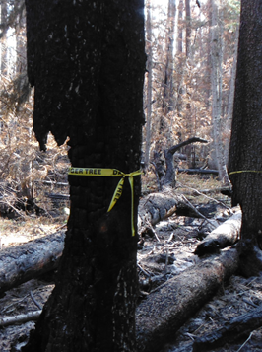
Communication of Hazards
Changes in fire behaviour must be communicated by radio.
All firefighters must be warned about fireline hazards.
Firefighters cannot work alone without a radio.

Slide 35
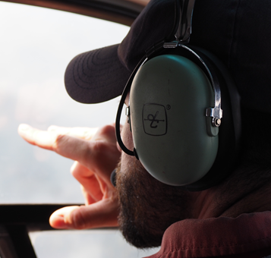
Communication Procedures
Be clear and concise.
Confirm transmissions have be received.
Check-in with supervisor as needed.
Know the emergency communication protocol.
Limit irrelevant radio transmissions.

Slide 36
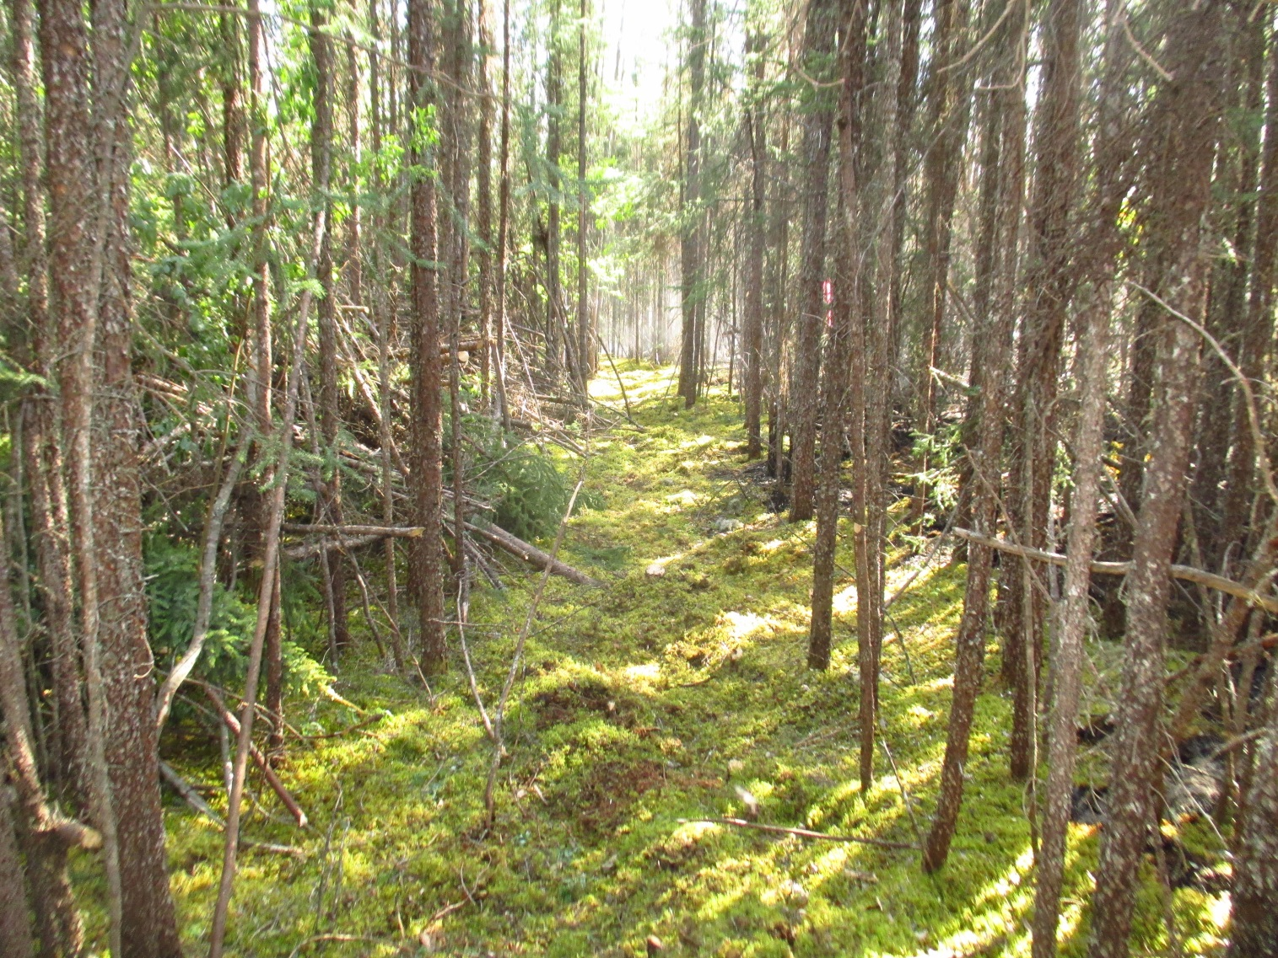
Escape Routes

Slide 37
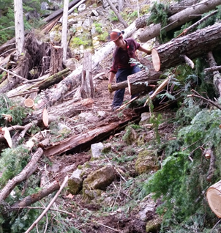
Escape Routes
There must be at least 2.
Need to be flagged, bucked, cleared and timed.
Control lines commonly used.
Allow for rapid access to safety zones.
Effectiveness dictated by fire behaviour.
Swamping Debris

Slide 38
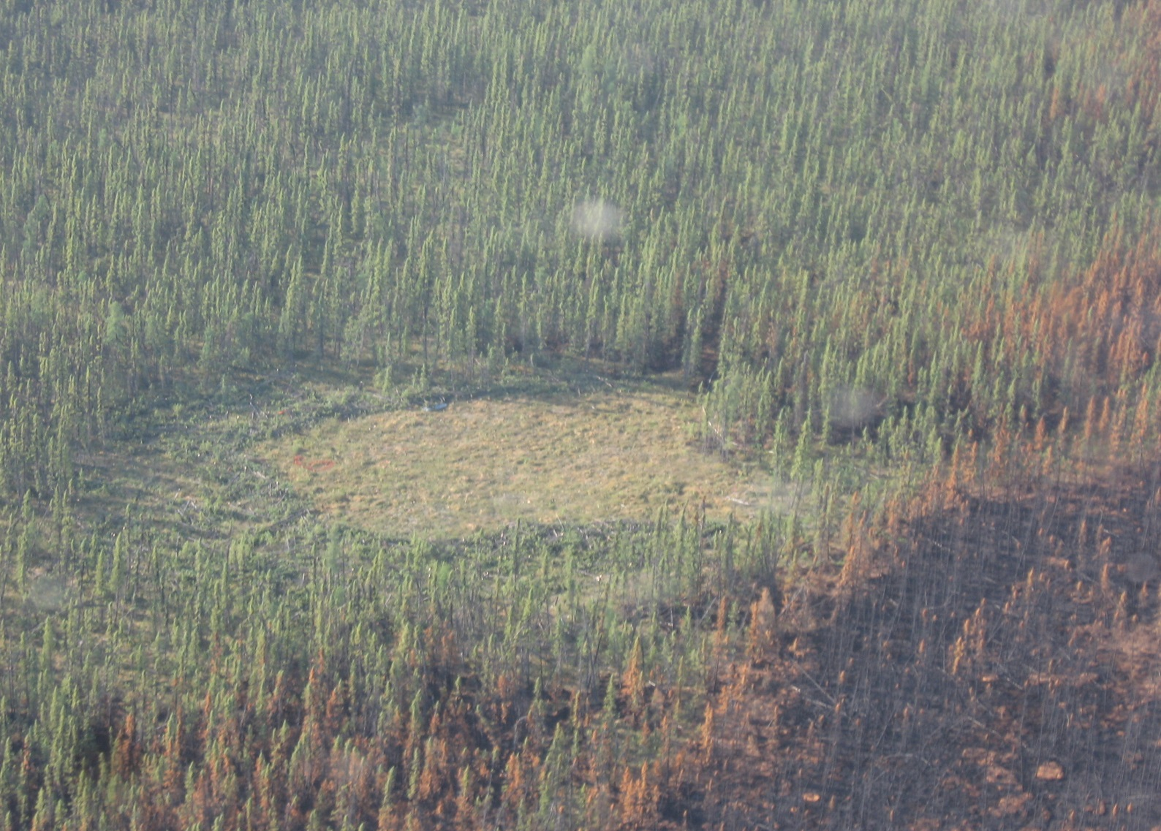
Safety Zones

Slide 39
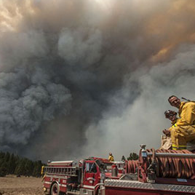
Purpose of Safety Zones
Are locations established along the fireline.
Firefighters can retreat to these areas.
Keep firefighters safe during fire entrapment scenarios.
Give firefighters refuge from all fire hazards.
Clear of Fire Hazards

Slide 40
Safety Zones Keep Wildfire Personnel Safe!
Need to protect fire personnel from:
flames.
radiant heat.
smoke.
burn debris.
falling timber.
dangerous trees.

Slide 41
Safety Zone Size Requirements
Has to provide fire personnel a space of 4 times possible flame lengths away from fire front.
  Can use adjacent timber size.
Must protect crews on all sides.
Needs to be big enough to shelter all fire personnel.
Will change based on wind and terrain.
Must be reassessed for changes in fire behaviour, control line progress and additional resources.

Slide 42
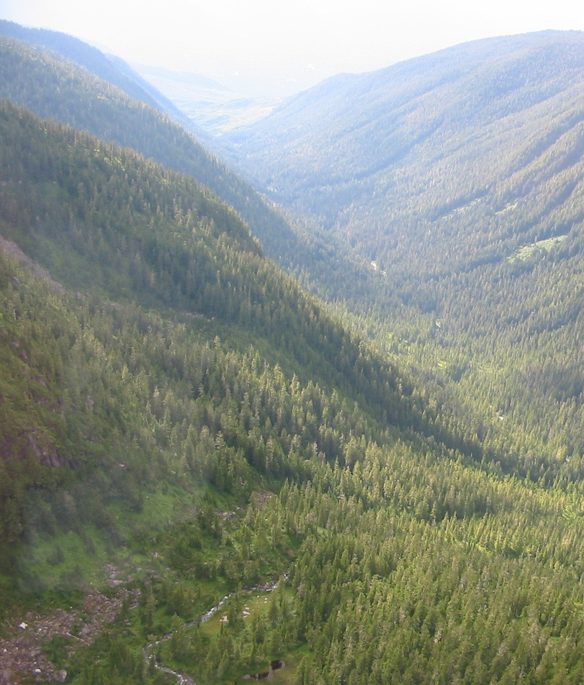
Safety Zone Locations
Limited
Safety Zones
Avoid the following:
Any chimneys, canyons or saddles.
Steep areas above the fire.
Narrow ridge tops.
Areas down wind of the fire.
Heavy fuels adjacent.

Slide 43
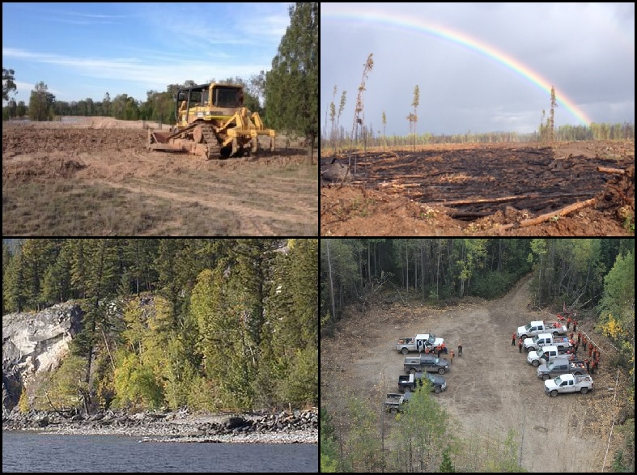
Possible Safety
Zones

Slide 44
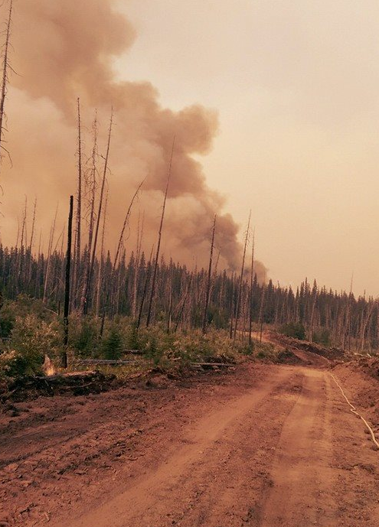
Safety Margin and Critical Distance
The safety margin is the time between arrival at a safety zone and fire encroachment.
Need to leave extra time.
Critical distance determines the crew’s trigger point for withdrawal.
Tactical Withdrawal

Slide 45
Safety Margin and Critical Distance Calculations
Safety Margin = Escape Time - Fire Arrival Time
e.g. Escape Time: 20 min. - Fire Arrival: 15 min.
= 5 min. SM
Critical Distance = Rate of Spread x (Escape Time + Safety Margin)
e.g. ROS: 15 m/min. x (Escape: 20 min. + SM: 5 min.) = 375 metre CD

Slide 46
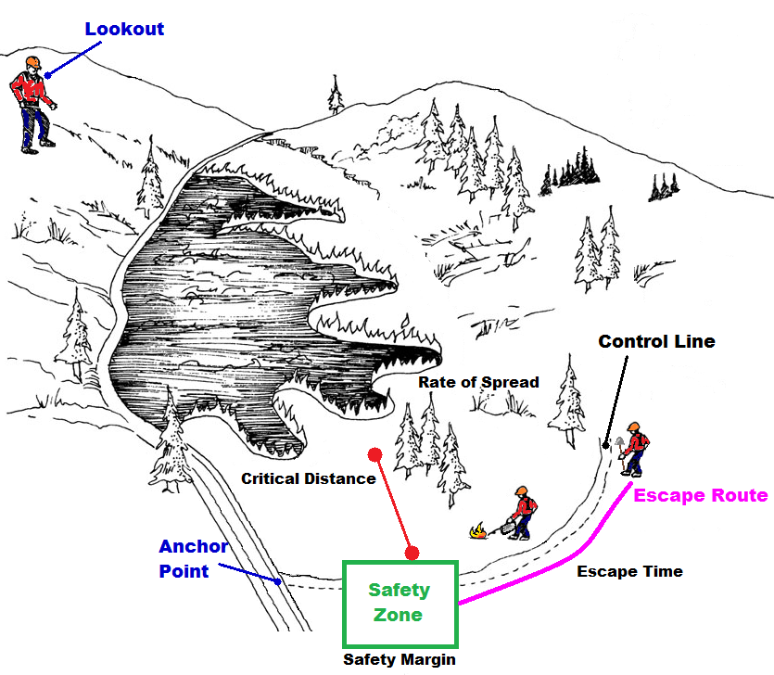
Safety Margin and Critical Distance

Slide 47
Fireline Disengagement
Supervisors may make the decision to withdrawal.
Due to fire behaviour and other hazards.
Firefighters will promptly use escape routes.
Firefighter will remain in safety zones.

Slide 48
The Right to Disengage
All firefighters have the right to disengage - Back Out.
Based on a firefighter’s opinion.
It is a firefighters responsibility to warn co-workers of this action.
If the risk of fire entrapment is high.
Supervisors must be made aware of the decision to withdraw immediately.

Slide 49
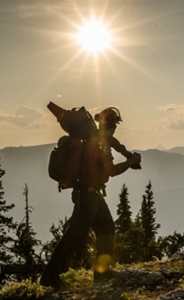
Fireline Disengagement Procedures
Follow your supervisor’s instructions.
Stay with the crew.
Keep your fireline gear.
Do not panic.
Do not run.
If you get separated, try to find your crew or a safe area to wait.

Slide 50
Your Role in Entrapment Avoidance
Maintain a safety first attitude at all times.
Ask questions during your safety briefings.
Use the LACES safe work system.
Know the fireline hazards.
Use your Situational Awareness.
Communicate with your supervisor and co-workers.

Slide 51
Fire Entrapment: Critical Review - Chisholm Wildfire
May 2001

Slide 52
Fire Entrapment: Critical Review
Separate into groups of 5, or into squads/crews.
Handout the Chisholm Fire Entrapment sample.
Explain the Chisholm incident with the trainees and discuss the Critical Review notes sections.
Groups will read the South Canyon and Yarnell Hill Fire Entrapment Incident Reports for - make notes.
Analyze the South Canyon and Yarnell Hill Incident videos - take more notes.
Each group will present finding and discuss the incident with the class.
Notes:
South Canyon Video:
Part 1 - https://www.youtube.com/watch?v=PqWa7QhhkMg
Part 2 - https://www.youtube.com/watch?v=0FZ98XJDzj0
Yarnell Videos:

Slide 53
Fire Entrapment: Critical Review
South Canyon Incident
Yarnell Hill Incident

Slide 54
Questions?
About fire
entrapment. . .
or Safety?
Close
Call

Slide 55
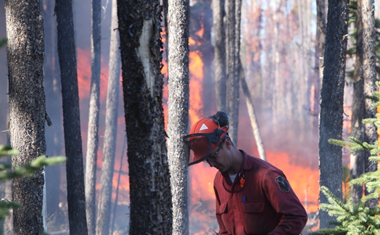
Fire Entrapment Survival
Get Out!

Slide 56
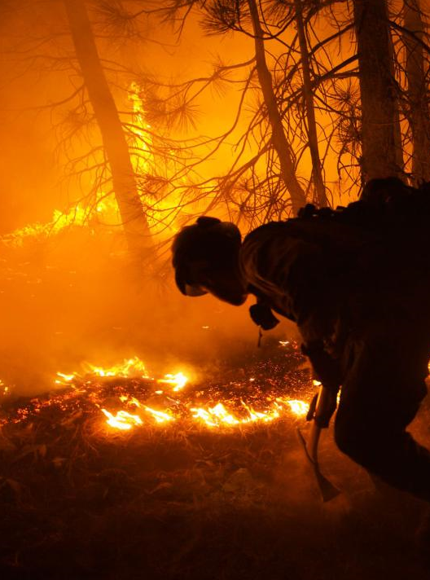
Fire Entrapment Survival
Fire entrapment is a life threatening situation.
Escape routes are blocked off.
Safety zones are inaccessible.
Firefighter need to use ‘Last Resort’ tactics.

Slide 57
Emergency Escape
Firefighters must decide if escape is possible.
Observe the fire behaviour.
Determine how fire activity is effecting escape routes.
Low intensity fronts can be breached to access safety zones.
Move to safety rapidly.
Communicate situation to supervisor.

Slide 58
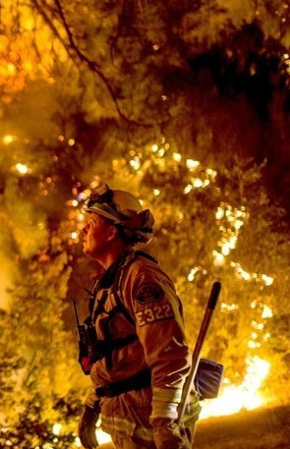
A Fire Entrapment Scenario
Supervisors must be aware of fire behaviour.
Supervisors will recognize potential entrapment.
Firefighters need to use personal judgment if alone.
Drop all fireline gear in emergency situations.
Observe The Fire Behaviour

Slide 59
Escape Travel Time
Dropping fire gear = 20 % faster travel speed.
Escaping uphill - decreases travel speed (that’s pretty obvious).
Improving escape routes = 40 % faster travel speed.
Decreasing escape time = increase survival in rates (also fairly obvious).

Slide 60
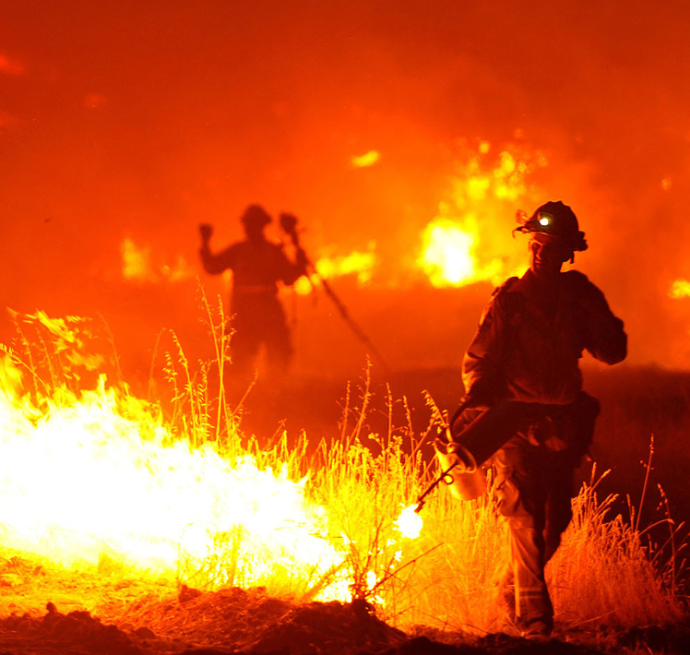
Fire Entrapment Survival Zones
Emergency Survival Zones
Are last resort safe areas.
Protects firefighters from flames and smoke.
Firefighters may burn out survival zones.
Not a safety zone due to smaller size.
Creating a Survival Zone

Slide 61
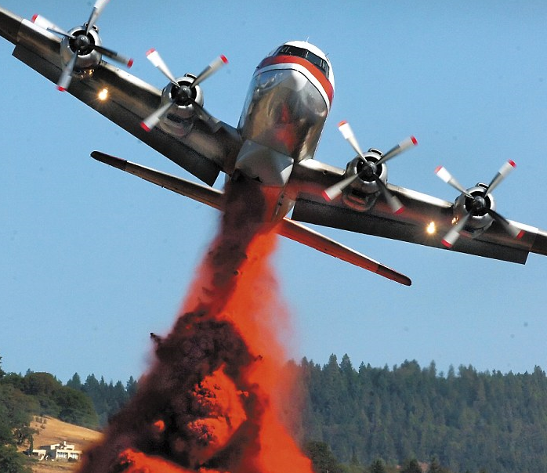
Survival Zones
Examples include:
  burnt areas.
  fuel free clearings.
  roads and dozer lines.
  rocky terrain.
  water sources.
Ask for retardant or water drops in area.

Slide 62
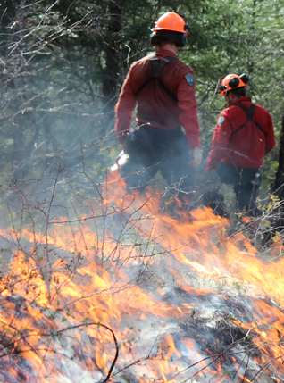
Fire Entrapment Survival Actions
Once in a survival zone:
Shelter in a fuel free section.
Find a depression or trench.
Use proper PPE for protection.
Lie face down and parallel to fire front.

Slide 63
Fire Entrapment Survival Actions
Stay as close to the ground as possible.
Protect head by curling arms.
Wet clothing if possible.
Cover body with dirt.
Dig a depression with hands to create a breathing well.

Slide 64
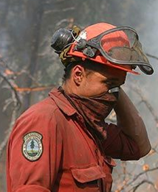
Airway Protection
Airway protection is critical.
Airways and lungs are the priority for survival.
Breathing in hot air and smoke can cause death.
Take short breaths close to the ground.
Avoid toxic gases.

Slide 65
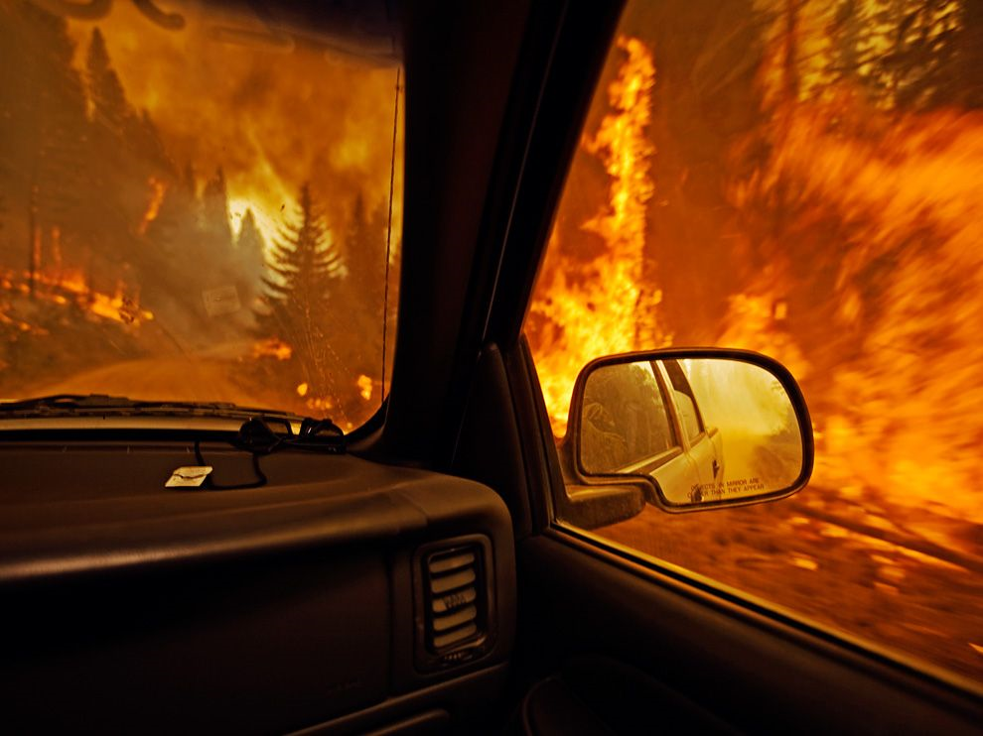
Vehicle Entrapments

Slide 66
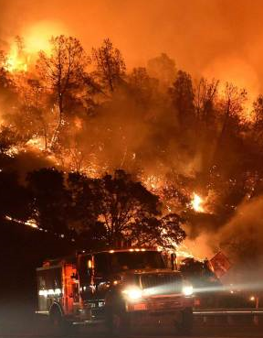
Using Vehicles as Shelter
Consider sheltering in a vehicle as a last resort.
Only if safety zone cannot be reached.
Do not move the vehicle if in a safe location.
Do not drive through smoke and flame.

Slide 67
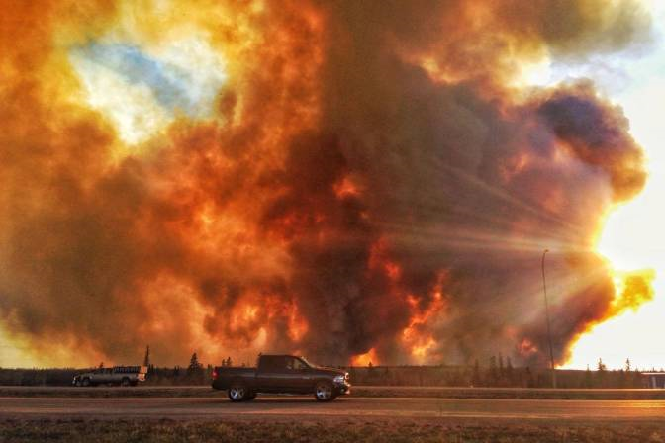
Parking for Vehicle Entrapments
Try to find a fuel free area to park.
Park at the widest section of roads.
Do not park: upslope of the fire, under power lines or under overhanging trees.
Position vehicle to provide best protection from fire.

Slide 68
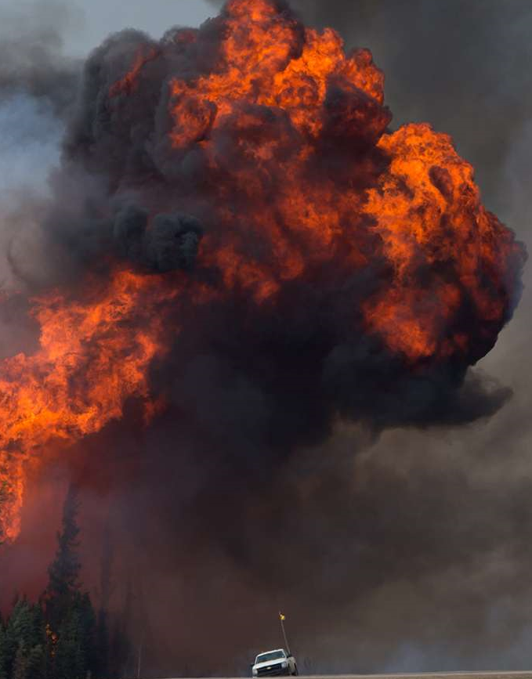
A Vehicle Entrapment
If in an entrapment situation:
Stay calm.
Communicate with a supervisor.
Burn fuels around vehicle if safe.
Ask for retardant or water drops in the area.
Is this an adequate Safety Zone?

Slide 69
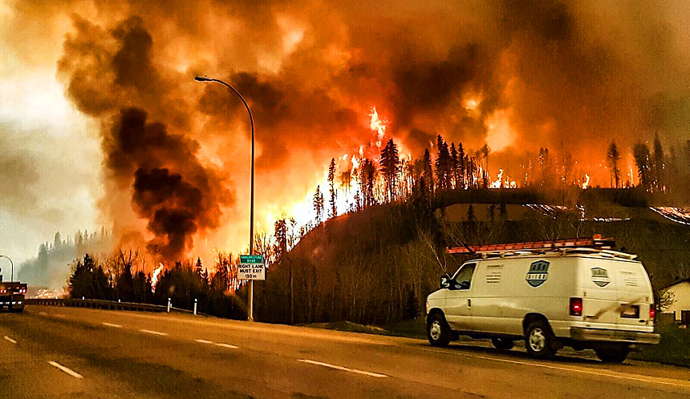
Vehicle Entrapment Safety
Apply the parking brake.
Keep the engine running.
Leave lights on.
Close all windows.
Unlock the doors.
Protect your airway at all times - smoke in cab.

Slide 70
Heavy Equipment Entrapments
Protect Your Operators!

Slide 71
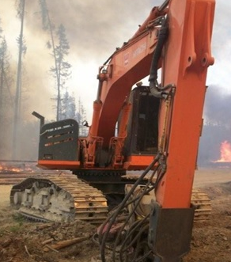
Entrapment Procedures for Equipment Operators
Operators need to use LACES.
Retreat is necessary if there is fire entrapment potential.
Heavy equipment can clear safety zone in an emergency.
Need good radio communications.

Slide 72

Heavy Equipment Entrapment
If fire behaviour changes suddenly:
Dig a trench with the machine and park in front.
Park the machine perpendicular to the fire.
Lower attachments and turn off engine.
Shelter under the machine.

Slide 73
Heavy Equipment Entrapment
Stay at the side away from the fire front.
Use the machine to shelter from:
  flames.
  radiant heat.
Stay low in the trench.
Use the survival actions and protect airway.

Slide 74
Building Entrapments

Slide 75

Wildland-Urban Interface Fires
Interface fires combined forest and building fuels.
Firefighters are asked to work around buildings.
Buildings can provide shelter during fire entrapment.
House Left Intact

Slide 76

Using a Building as Shelter
A building must be a sufficient barrier.
Move all fuels away.
Remove propane tanks.
Burn out around building if possible.
Ask for retardant, foam or water drops.

Slide 77
Interior Entrapment Preparation
Fill all water containers including sinks.
Remove possible fuels from window areas.
Close all windows and vents - except chimney.
Use wet sheets, towels and rags as door jams - to reduce smoke.

Slide 78

Building Entrapment
Stay on the ground floor.
Maintain access to a door or window.
Avoid basements and upper floors.
Be prepared to exit the building quickly.

Slide 79
Escaping from the Building
If it is necessary to leave the building:
Try to wait until the flame front has passed.
Wet down clothes.
Stay low to the ground.
Use the entrapment survival actions.
Protect airways at all times.

Slide 80
Your Role in Entrapment Survival
Communicate any entrapment situations with your supervisor.
Ask for help!
Use Escape Routes and Safety Zones if possible.
Use the appropriate entrapment survival actions.
Always protect your airways during a fire entrapment scenario.

Slide 81
Questions?
About fire entrapment survival?

